Slide 1


Khalid Salem
17/12/2022

Slide 2

Outline
Executive Summary
Introduction
Methodology
Results
Conclusion
Appendix

Slide 3
Executive Summary
Summary of methodologies :
Collecting data through API
Web Scraping for Data Collection
Data Cleaning and Preparation
Exploratory Data Analysis (EDA) with SQL
Data Exploration through Visualization
Interactive Visualizations using Folium
Predictive Modeling with Machine Learning
Summary of all results
Results from Exploratory Data Analysis
Interactive Analytics Visualized via Screenshots
Predictive Analytics Outcomes

Slide 4
Introduction
Project background and context
Our goal is to predict whether the Falcon 9's first stage will land successfully. SpaceX offers its rocket launches for $62 million, much cheaper than other providers, whose prices are often over $165 million. A big part of this cost difference comes from SpaceX's ability to reuse the first stage of the rocket. If we can predict whether the first stage will land successfully, we can get a better idea of the overall cost of a launch. This could be useful for other companies looking to compete with SpaceX in the space launch market.
Problems you want to find answers
Can machine learning models accurately predict landing success, and which model performs best?
What patterns or trends can we identify in SpaceX's launch success rates over time
What is the impact of environmental factors, such as weather or geographic location, on landing outcomes?

Slide 5

Section 1

Slide 6
Methodology
Executive Summary
Data collection methodology:
Gathering data from the SpaceX REST API for information on launches, rockets, and missions, complemented by web scraping from reliable sources to enrich the dataset.
Perform data wrangling
Clean and preprocess the data by filtering irrelevant entries, addressing missing values using suitable imputation techniques
Perform exploratory data analysis (EDA) using visualization and SQL
Analyze the dataset using SQL for querying and leverage data visualization techniques to uncover patterns and insights.
Perform interactive visual analytics using Folium and Plotly Dash
Create interactive and informative visualizations using tools like Folium for geospatial data and Plotly Dash for dynamic dashboards.
Perform predictive analysis using classification models
Build and train classification models to predict landing outcomes, optimize performance through hyperparameter tuning, and evaluate models to identify the best fit for the task.

Slide 7
Data Collection
Data was gathered from the SpaceX API by requesting rocket launch information. The response was decoded using .json() and then converted into a dataframe using .json_normalize(). Custom functions were employed to request detailed launch data, which was stored in a dictionary. This dictionary was then used to create a dataframe, which was filtered to include only Falcon 9 launches. Missing payload mass values were replaced with the calculated mean. Finally, the cleaned data was exported to a CSV file for further analysis.

Slide 8
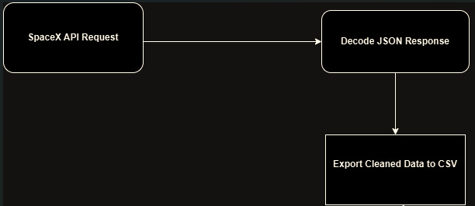
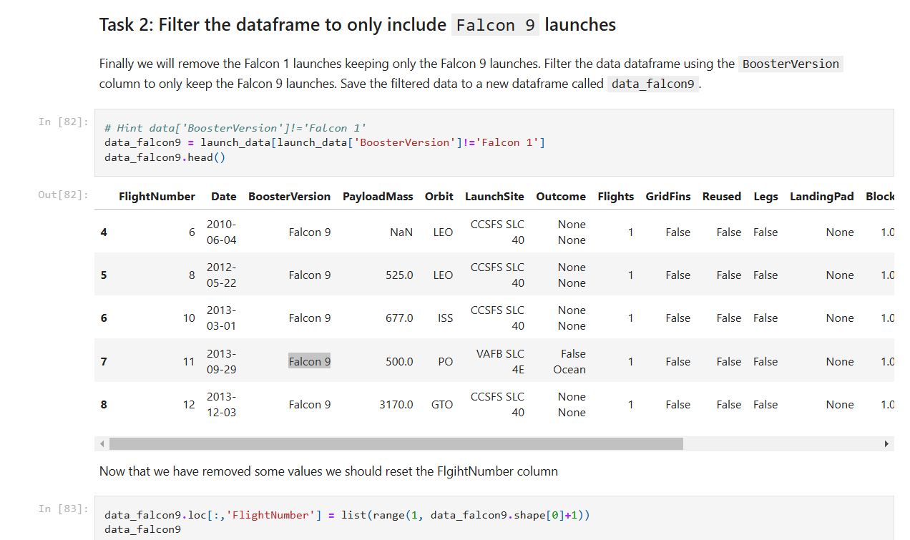
Data Collection – SpaceX API
Present your data collection with SpaceX REST calls using key phrases and flowcharts
First, we retrieve the Falcon 9 launch wiki page by accessing its URL.Next, we extract the column or variable names from the header of the HTML table.Finally, we parse the HTML tables to construct a dataframe containing the launch data.
All the Calls here in the Collection file in GitHub

Slide 9
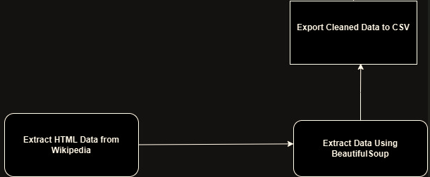
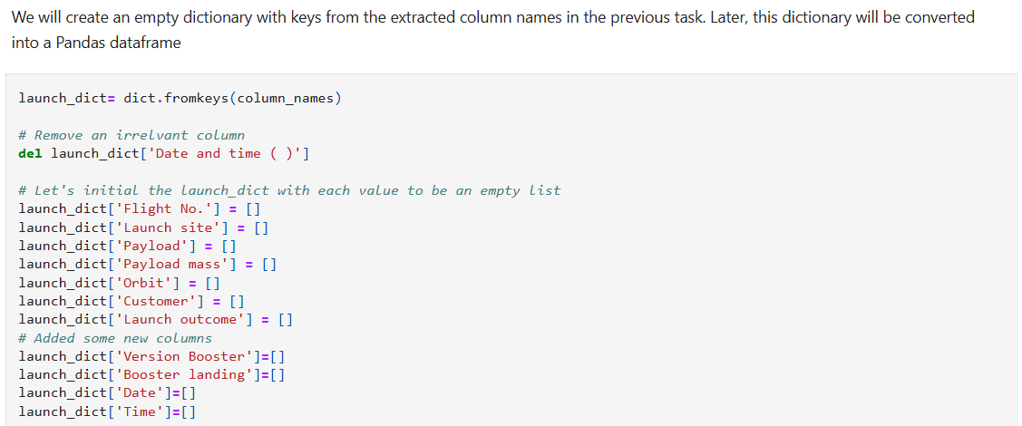
Data Collection - Scraping
Initially, we fetch the Falcon 9 launch wiki page using its URL. We then extract the column or variable names from the header of the HTML table. Finally, we parse the launch-related HTML tables to build a dataframe.
Web Scraping file in GitHub

Slide 10
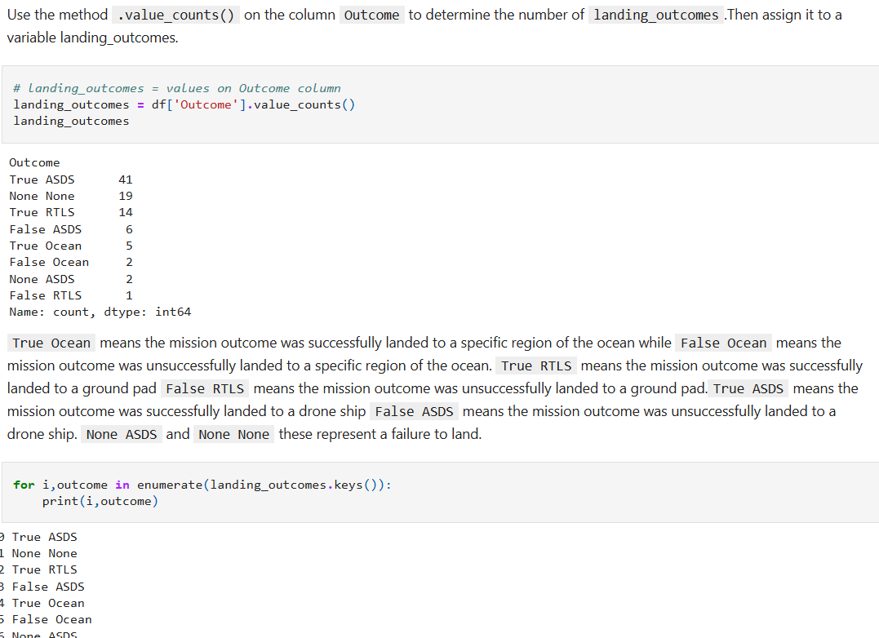
Data Wrangling
We start by calculating the total number of launches at each site to understand launch frequency.Next, we count and determine the frequency of each orbit type used in the missions.Then, we analyze the occurrence of mission outcomes for each orbit type to evaluate success rates.Finally, we create a landing outcome label based on the "Outcome" column to classify each mission's landing result.
Here is the link for all the steps in GitHub

Slide 11
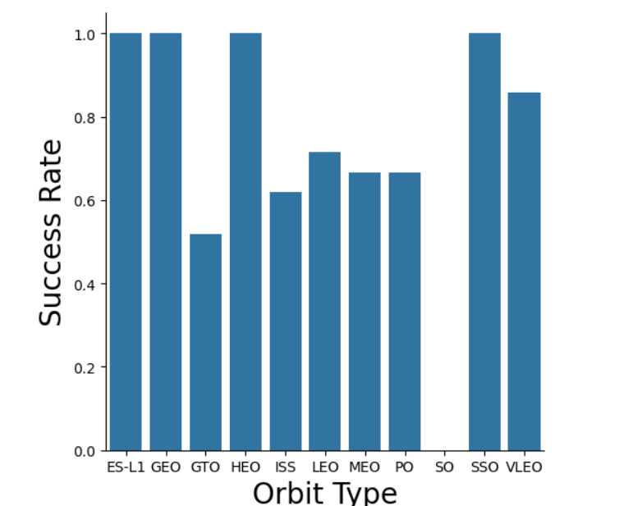
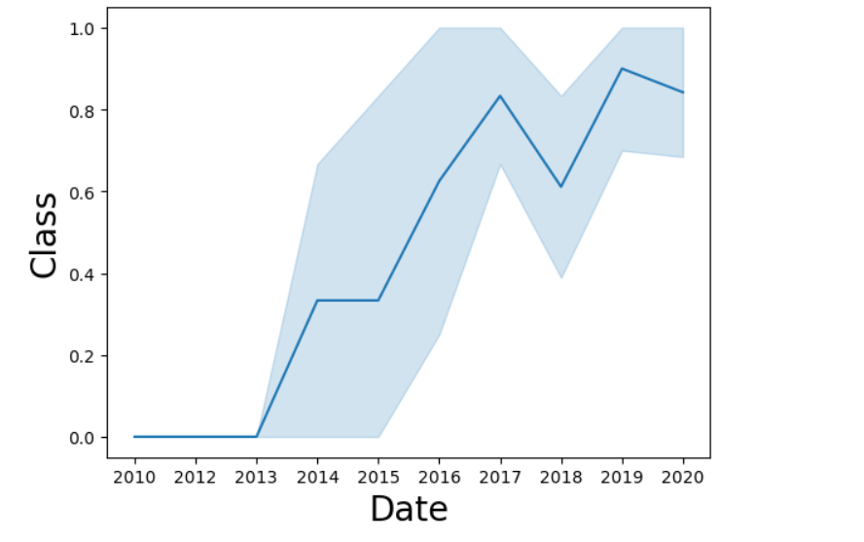
EDA with Data Visualization
The first image presents a bar chart that displays the relationship between the success rate of each orbit type.
The second image uses a line chart to visualize the yearly trend of launch success over time.
Here is the link for the Data Visualization in GitHub

Slide 12
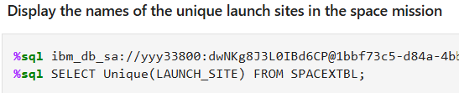
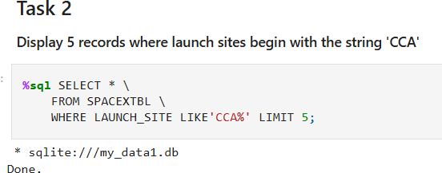
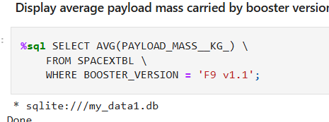
EDA with SQL
Some examples for the process of EDA with SQL:
Displaying five records where the launch sites start with the string 'CCA’.
Calculating the average payload mass carried by the F9 v1.1 booster version.
Listing the total number of successful and failed mission outcomes.
Link for GitHub

Slide 13
Build an Interactive Map with Folium
We plotted all launch sites on a map using their latitude and longitude coordinates. Success and failed launches for each site were marked on the map to visualize performance. We also calculated the distances from each launch site to nearby proximities. From the insights gained about the launch sites, we can conclude that:
The sites are located near railways, facilitating the transport of heavy rocket components.
They are situated close to highways, ensuring easy access for personnel.
The proximity to coastlines minimizes the risk of debris falling on populated areas in case of failures.
The sites maintain a safe distance from cities to reduce the impact of potential rocket failures.
Here is the link for GitHub

Slide 14
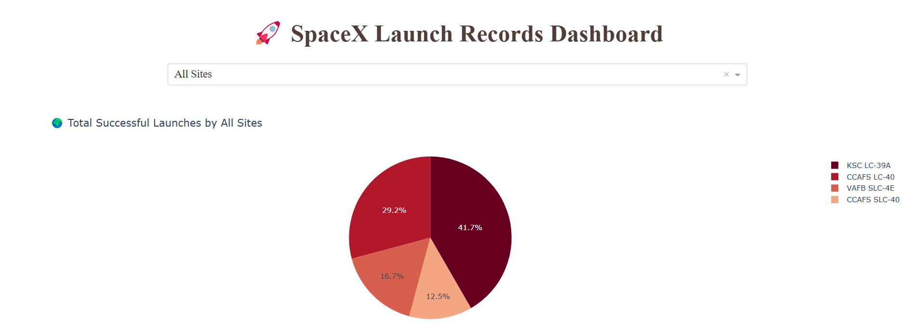
Build a Dashboard with Plotly Dash
A dashboard was created using Plotly Dash, featuring pie charts that display the total number of launches for each site. Additionally, a scatter plot was included to visualize the relationship between launch outcomes and payload mass for different versions of the booster.
Link for GitHub

Slide 15
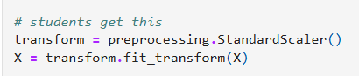
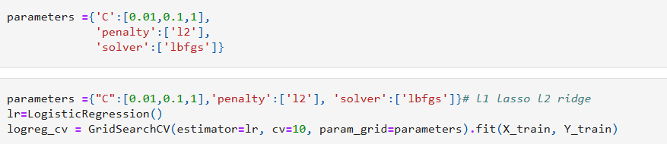
Predictive Analysis (Classification)
Using Numpy and pandas, we transformed the data and split it into training and testing sets. We then built various machine learning models and applied GridSearchCV to fine-tune hyperparameters. In the end, we identified the best-performing model based on the results.
Link for GitHub

Slide 16
Results
Exploratory data analysis results
Interactive analytics demo in screenshots
Predictive analysis results

Slide 17

Section 2

Slide 18
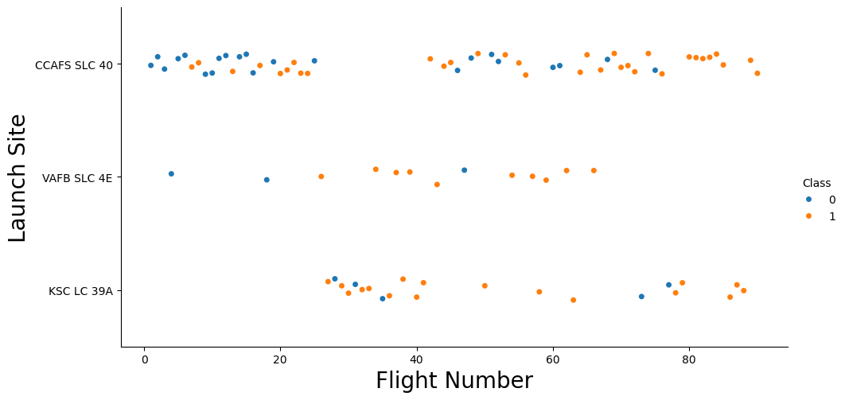
Flight Number vs. Launch Site
Most launches occurred at CCAFS SLC 40 followed by KSC LC 39A and then VAFB SLC 4E
The number of successful launches increases significantly across all launch sites, particularly after earlier failures.

Slide 19
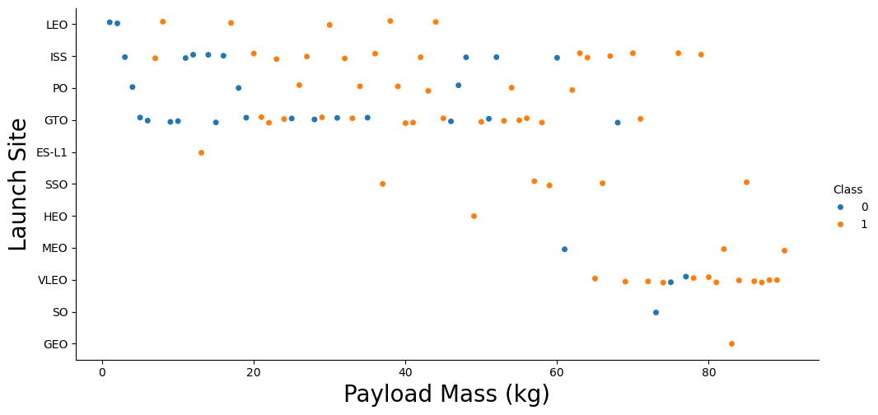
Payload vs. Launch Site
The failure rate is highest for payload masses ranging between 4,000 kg and 6,000 kg.
Overall, success rates tend to increase as payload mass increases.

Slide 20
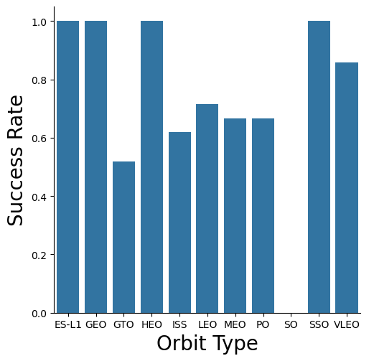
Success Rate vs. Orbit Type
We can see there is no success in the orbit SO
The top four orbit in the chart are : ES-L1 and GEO and HEO and SSO, they share the same rate of success

Slide 21
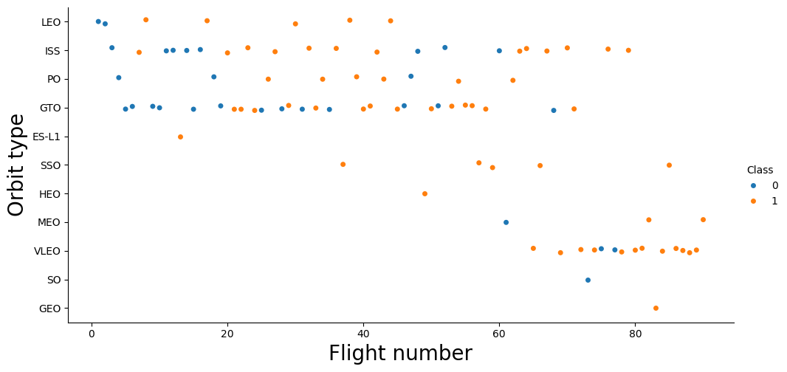
Flight Number vs. Orbit Type
Launches to VLEO orbit have shown an increasing trend in recent years.
The success rate for LEO orbit improves with an increasing number of flights.

Slide 22
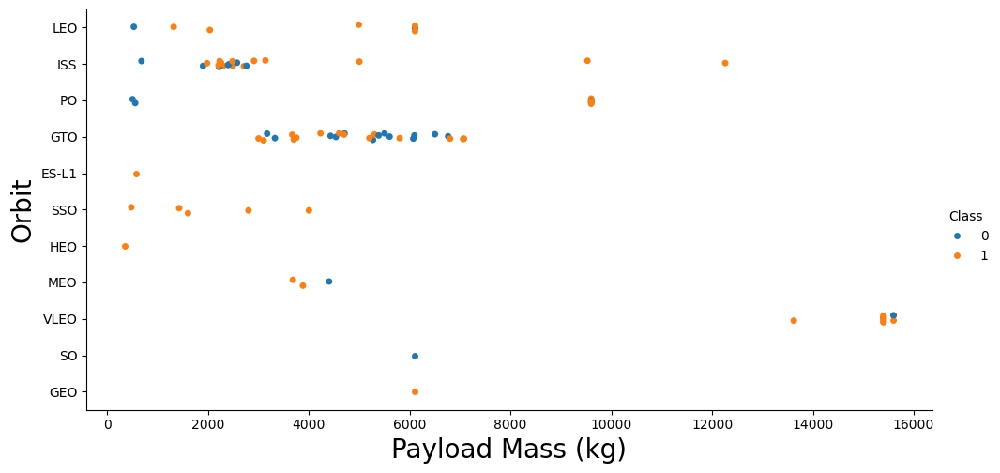
Payload vs. Orbit Type
Payload masses between 3,000 and 8,000 kg have a significant impact on GTO orbit.
For heavy payloads, the success rate is higher in ISS, LEO, and PO orbits.

Slide 23
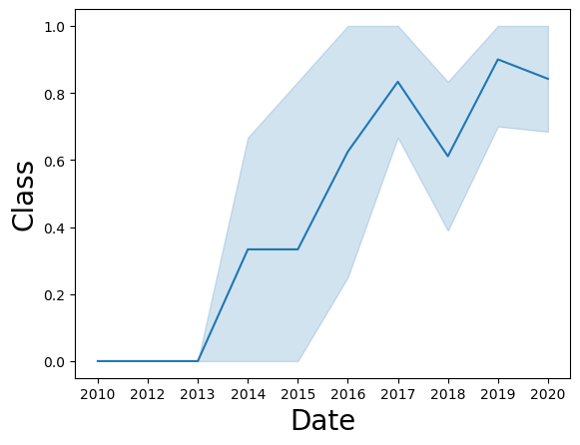
Launch Success Yearly Trend
The success rate has steadily improved from 2013 to 2020, reflecting advancements in launch technology, operational experience, and mission reliability.
In the early years (2013-2015), the success rate was relatively lower, with a noticeable presence of mission failures.

Slide 24
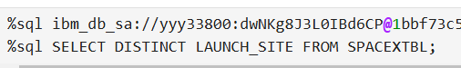
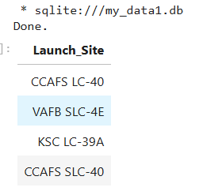
All Launch Site Names
By the action DISTINCT we get the unique launch stites

Slide 25
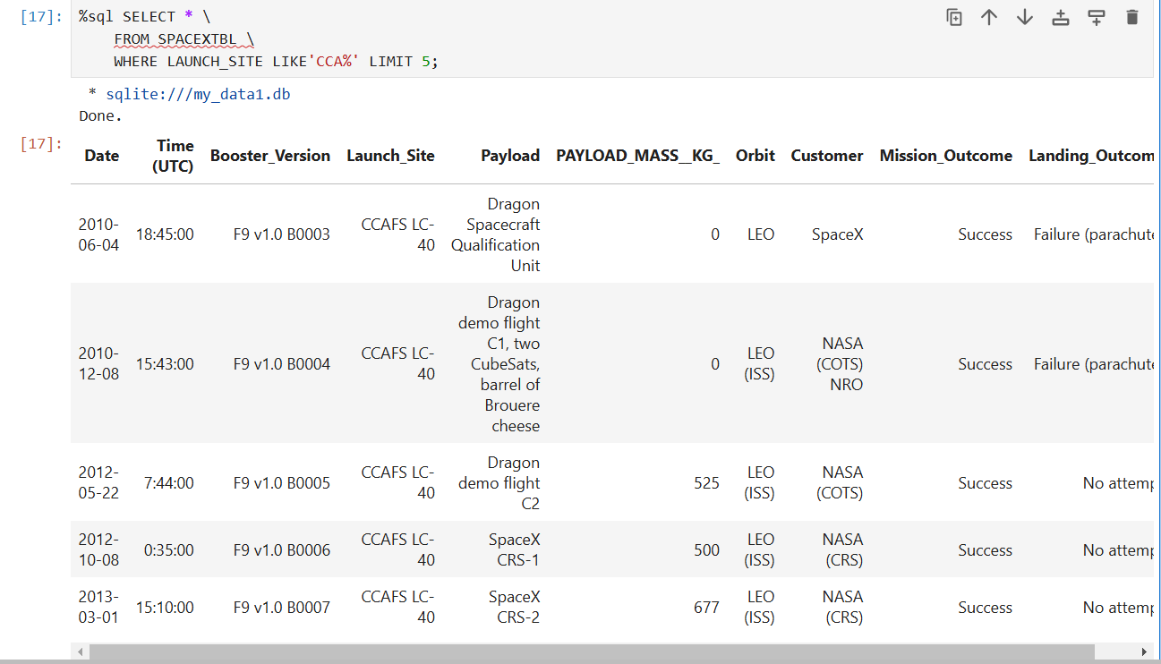
Launch Site Names Begin with 'CCA'
We get the CCA by using LIMIT keyword in query.

Slide 26
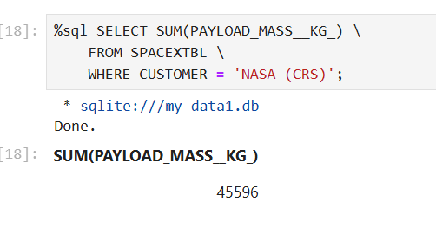
Total Payload Mass
By using SUM in payload mass kg we get the result of the summing in the table

Slide 27
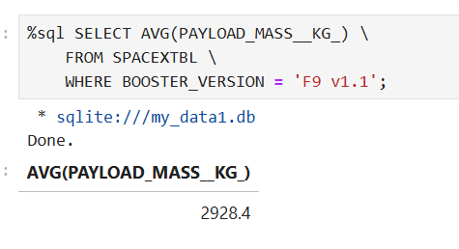
Average Payload Mass by F9 v1.1
By using AVG in payload mass kg we get the result of the summing in the table of F9 v1.1

Slide 28
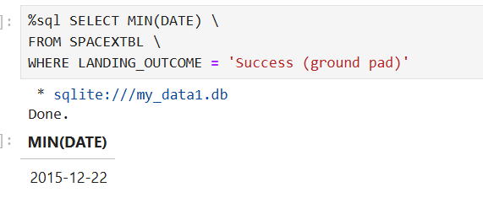
First Successful Ground Landing Date
The first successful ground landing pad date (2015-12-22) can be obtained using the MIN keyword, as the earliest date is considered the minimum value in a dataset.

Slide 29
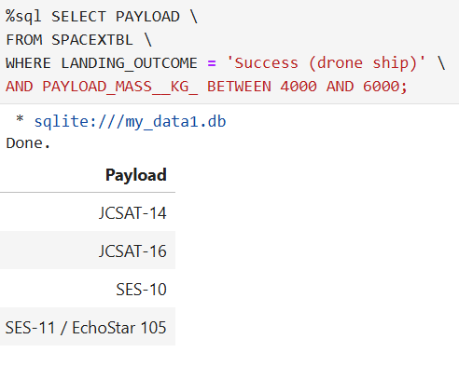
Successful Drone Ship Landing with Payload between 4000 and 6000
The first successful drone ship landing with a payload between 4,000 and 6,000 kg can be retrieved by filtering the data where the landing outcome is set to "Success (drone ship)".

Slide 30
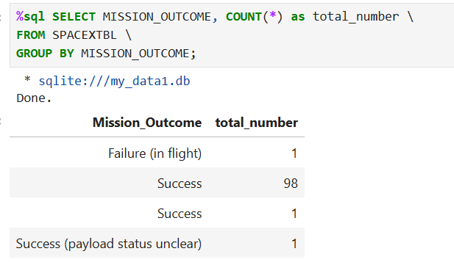
Total Number of Successful and Failure Mission Outcomes
By using COUNT keyword we can get the total number of each mission outcome

Slide 31
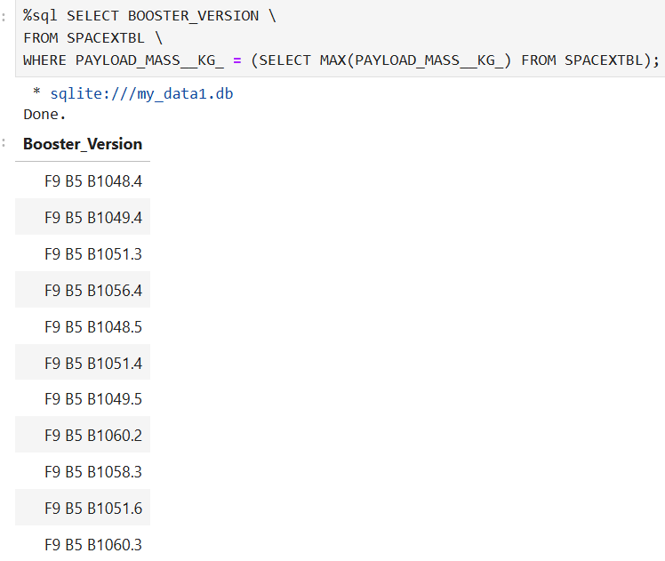
Boosters Carried Maximum Payload
The boosters that carried the maximum payload (15,600 kg) can be identified using the MAX keyword, as it retrieves the maximum payload value from the dataset.

Slide 32
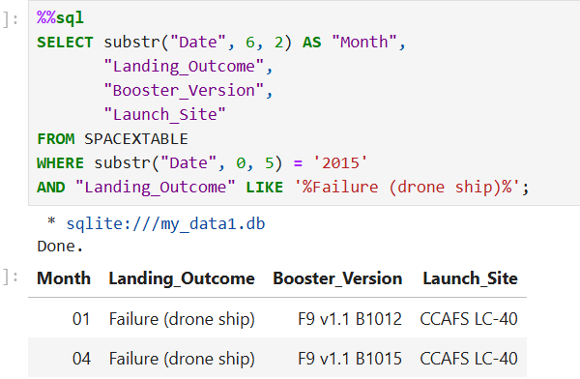
2015 Launch Records
The 2015 launch records can be retrieved by using the SUBSTR keyword to extract the year from the date field and setting the condition in the WHERE clause to filter records where the year equals '2015'.

Slide 33
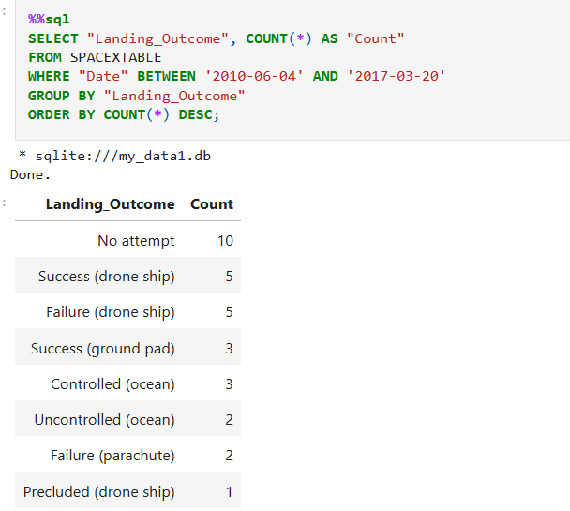
Rank Landing Outcomes Between 2010-06-04 and 2017-03-20
The values can be ordered in descending order using the DESC keyword, and the COUNT keyword can be used to display the total number of records for each ordered value.

Slide 34

Section 3

Slide 35
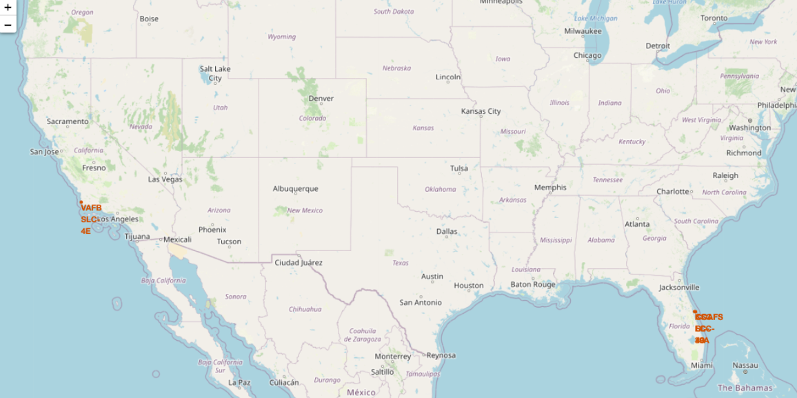
Global SpaceX Launch Locations
SpaceX launch sites are situated on the coasts of California and Florida in the United States.

Slide 36
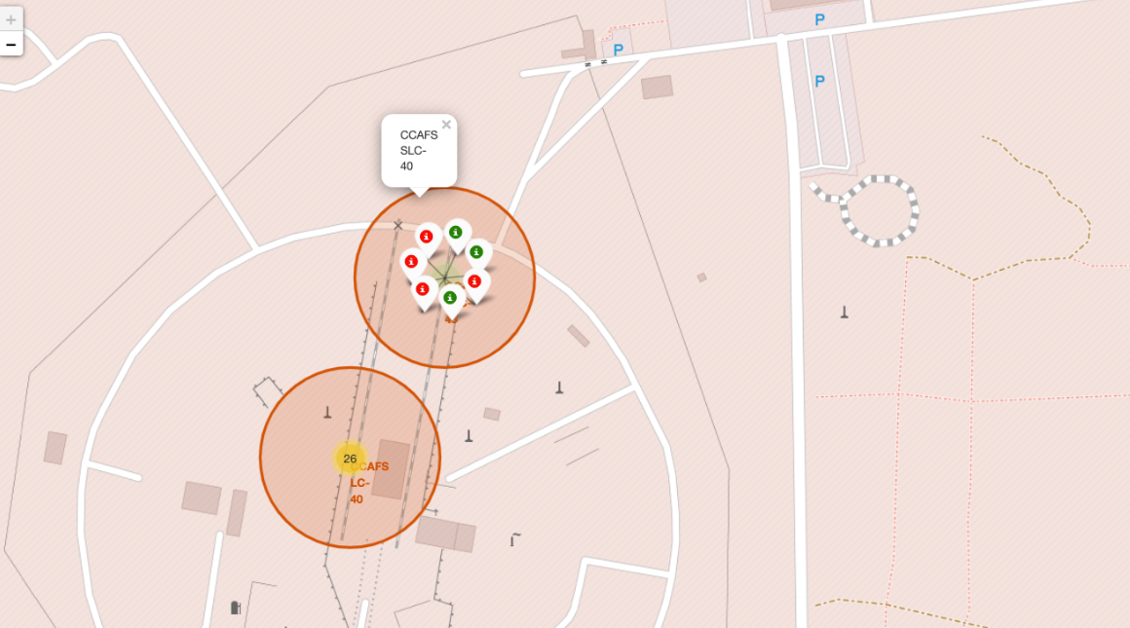
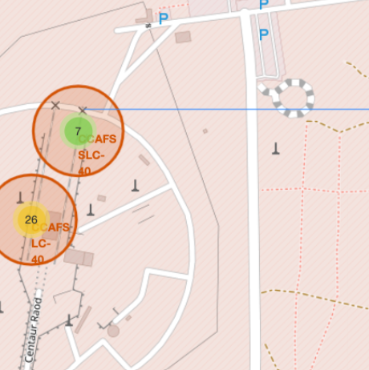
Map Marker
Marker for Florida launch site and California

Slide 37
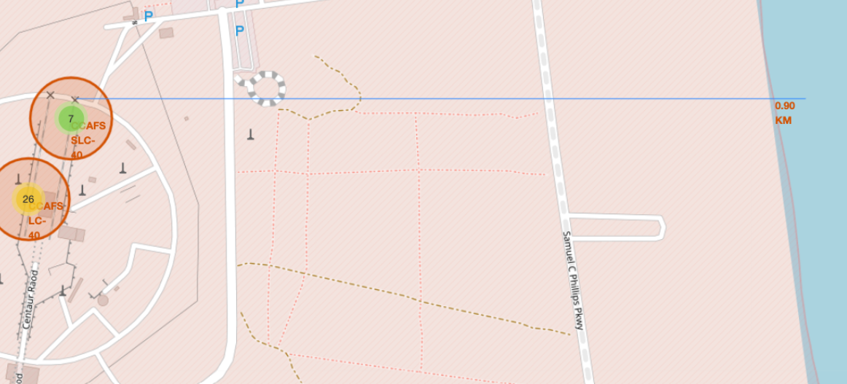
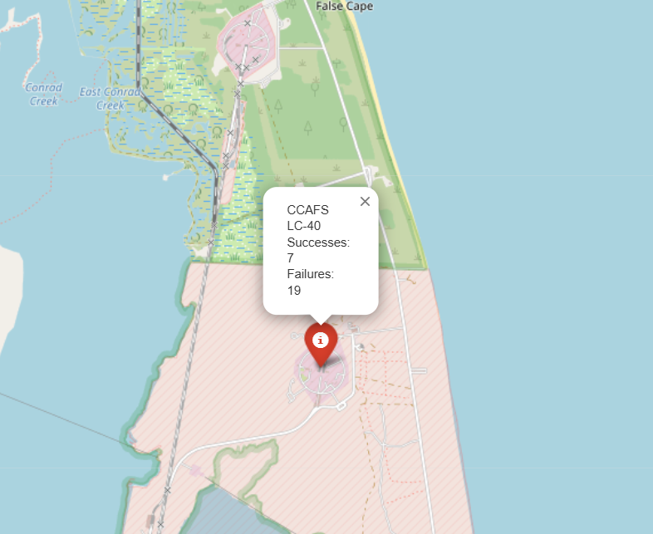
Proximity between Launch Sites and Landmarks
The following distances are shown between Launch Sites and Landmarks:
Distance to the closest coastline
Distance to the nearest highway

Slide 38

Section 4

Slide 39
Pie chart for the successful launch sites
Its clear that the KSC LC-39A records the highest success rate.

Slide 40
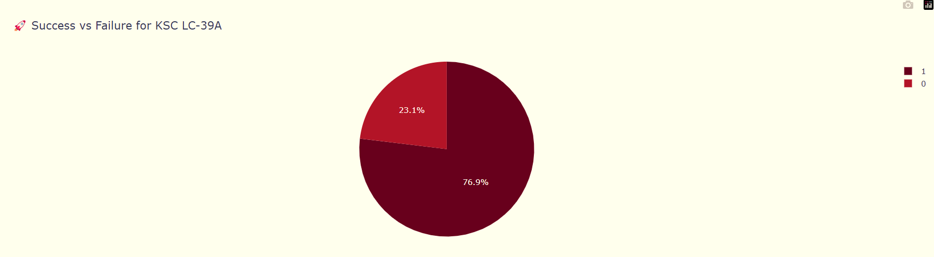
The highest successful launch site rate
KSC LC-39A has a success rate of 76.9% and a failure rate of only 23.1%.

Slide 41
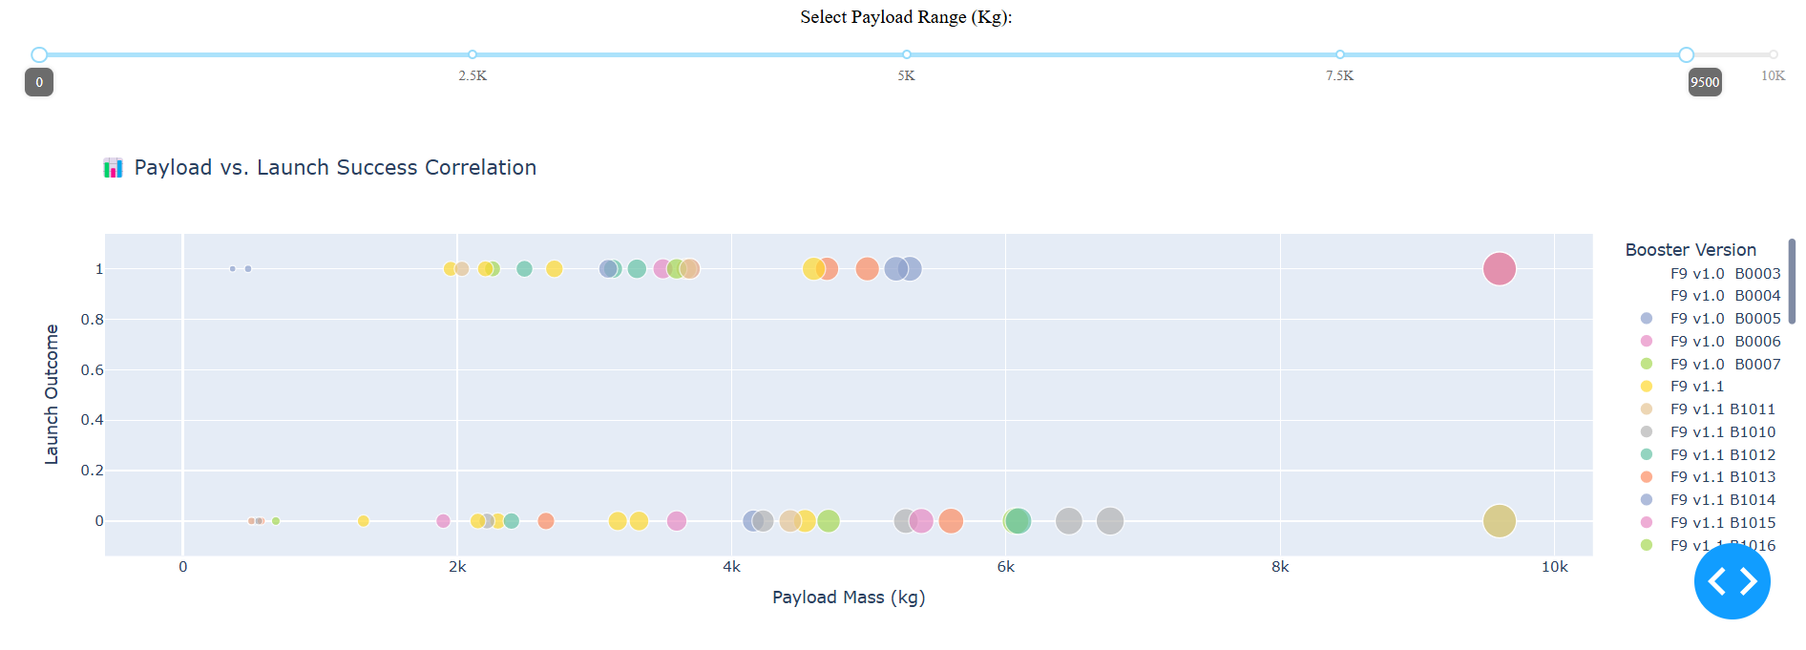
Scatter plot of Payload correlation with launch site
The success rate is higher for lighter payloads from zero to five thousand kg compared to heavier payloads from five thousand to ten thousand kg

Slide 42

Section 5

Slide 43
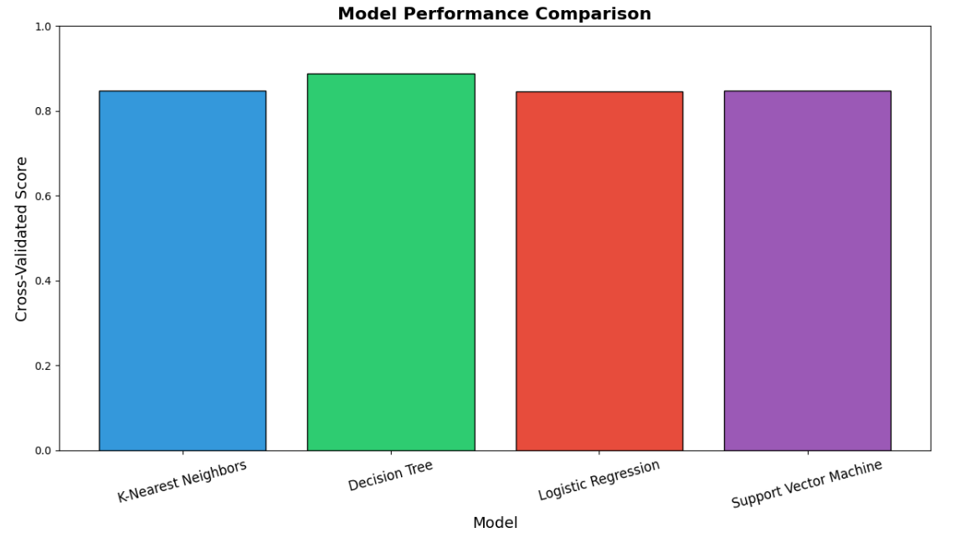
Classification Accuracy
The best model was the decision tree as shown, with accuracy score of 0.88

Slide 44
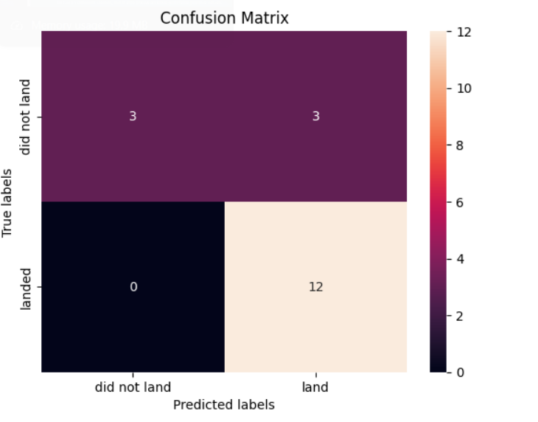
Confusion Matrix
The confusion matrix of the decision tree classifier clearly indicates its ability to distinguish between different classes, but it also highlights a problem with false positive values.

Slide 45
Conclusions
Decision Tree is the best-performing model, effectively distinguishing between classes, though there is an issue with false positives that needs addressing.
The launch success rate began to rise significantly in 2013, peaking in 2019, reflecting advancements in SpaceX's capabilities and technologies.
It is preferable for launch sites to be located near coastlines, highways, and railroads, while avoiding proximity to populated areas. This ensures easier access and enhances safety during launches.
The launch site with the highest success rate is KSC LC-39A, showcasing its efficiency and reliability in launch operations.

Slide 46
Appendix
You can find all my work within this project of SpaceX in My GitHub Page :
https://github.com/KhalidS98/IBM-Data-Science-Capstone-Project/tree/main

Slide 47


